Slide 1
HNDIT1106 – Web Development
Chapter 4 : Types of websites

Slide 2
Course Content
Static and Dynamic websites
Web Syndication and Collaborative websites
Web 1.0 and Web 2.0

Slide 3
Website
A website is a collection of related web pages containing images, videos or other digital assets.
A web page is a document, typically written in plain text with formatting instructions of Hypertext Markup Language (HTML, XHTML).
Other languages are;
Java script
XML
VB script

Slide 4
Basic Website Types
The first two have very little to do with Small Business, so we will speed through them.
1. Personal Websites 2. Photo Sharing Websites
3. Community Building Websites 4. Mobile Device Websites 5. Blogs
6. Informational Websites 7. Online Business Brochure/Catalog 8. E-commerce Websites
Numbers three, four, and five can be very helpful to small businesses.
The last three are essential to small business.

Slide 5
Static and Dynamic web sites

Slide 6
Static web Sites
For a static-content Web site, all content appearing on Web pages is placed manually by professional Web developers.
This is also called "design-time page construction," because the pages are fully built while the site is being developed.
Static-content Web site is developed and then maintained by experienced professionals.
Such Web site usually costs less when initially developed, but then all future changes still have to be done by Web professionals.
Therefore, a static Web site can be more expensive to maintain, especially when you want to make frequent changes to your site.

Slide 7
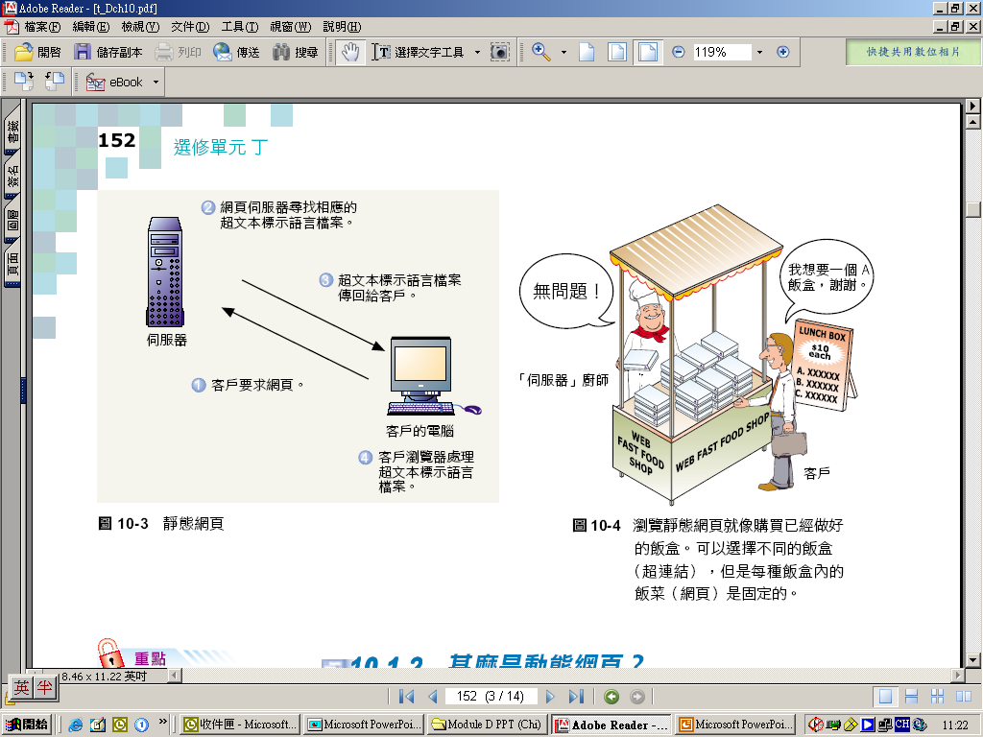
Static web Sites…(cont.)
Static web page
a web page with contents that remain fixed and unchanged once it has been created by the author
2. Web server looks for the corresponding HTML files
3. HTML files return to client
4. Client browser formats HTML files
1. Client requests
web pages
Client computer
Web server

Slide 8

Static web Sites…(cont.)
Static pages architecture:
Server
Browser sends request
Browser
Server returns document (s)

Slide 9
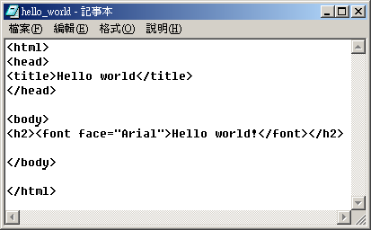
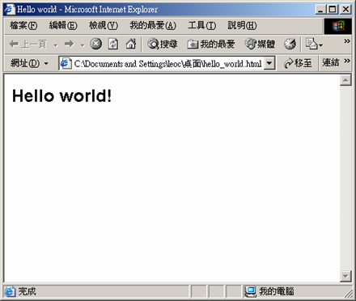
Static web Sites…(cont.)
Static web page

Slide 10
Static web Sites…(cont.)
Static web sites are mainly focused on showing permanent information , where the navigator is limited by itself to obtain the data.
Static web sites can not interact with this information, without interacting with the visited web page.
These kind of web are not able to support web applications as intelligent data base managers, forums, consultations on line, intelligent e-mails...

Slide 11
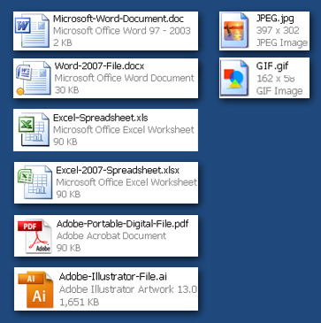

Static Websites - Pages
Web Pages exist as individual files
Some file types that may be familiar
MS WORD DOC .doc, .docx
MS EXCEL .xls, xlsx
ADOBE FILES: .pdf, .psd, .ai.
Digital Camera Files .jpg, .tiff
Examples of typical static web page files
.htm
.html
Notes:
Joint Photographic Experts Group Graphic Interchange Format

Slide 12
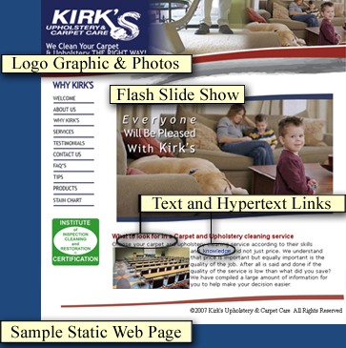
Static Websites - Pages (continued)
Pages typically contain text, hyper links, photos, and graphics
Pages may also contain animated or interactive media such as:
Movie Clips (YouTube etc.)
Adobe Flash Presentations
Microsoft Silverlight
Other media types
Pages are called Static because text, photos, and other content will not change unless the
actual web page file itself is edited.

Slide 13
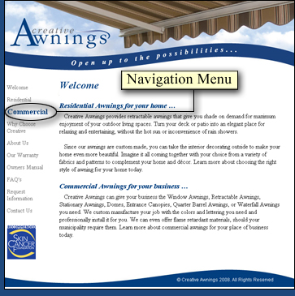
Static Website Navigation
Pages are associated with each other by a menu of links or “Navigation Menu”
Changes to the main Navigation Menu will require an edit to every web page that contains this menu.
Web development software can automate Navigation Menu maintenance, but pages will still need to be re-published for changes to take effect.

Slide 14
Advantages
Static web Sites…(cont.)
Quick to develop
Cheap to develop and host
Quick and easy to put together even by someone who doesn’t have much experience
A static web site can be created without any special type of programming ( php , asp ) .
Disadvantages
The only disadvantage of the static websites resides on the hard updating as well as the loss of powerful tools supported with data bases, like the creation of historical registers of the clients, orders online ..

Slide 15
Dynamic web Sites
Dynamic websites contain Web pages that are generated in real-time.
A web page with contents generated “on-the-fly” by the server or the client computer according to clients’ requests
These pages include Web scripting code, such as PHP or ASP.
When a dynamic page is accessed, the code within the page is parsed on the Web server and the resulting HTML is sent to the client's Web browser.
e.g. return the system’s current date and time to the server browser (written in Active Server Page)

Slide 16
Dynamic web Sites… (cont.)
Dynamic-content Web site, while still developed by professionals, can be maintained directly by you, our customer.
Such Web site initially costs more to develop, but then you don't have to pay Web professionals every time you need to change something on your site.
If you plan to make frequent changes to your site, you most likely will be better off with a dynamic Web site.

Slide 17
Dynamic web Sites… (cont.)
Examples of dynamic website features could be:
content management system
e-commerce system
bulletin / discussion boards
intranet or extranet facilities
ability for clients or users to upload documents
ability for administrators or users to create content or add information to a site (dynamic publishing).

Slide 18
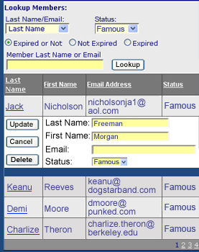
Dynamic Websites
Employ Dynamic pages that exist as files with extensions based on the type of programming used.
.jsp , .cfm, .pl, .php, .asp, .aspx
Pages are Dynamic in that they can draw ever changing Content from external information sources
Pages can provide Create, Retrieve, Update, and Delete functions for company records
Pages may not require
republishing

Slide 19
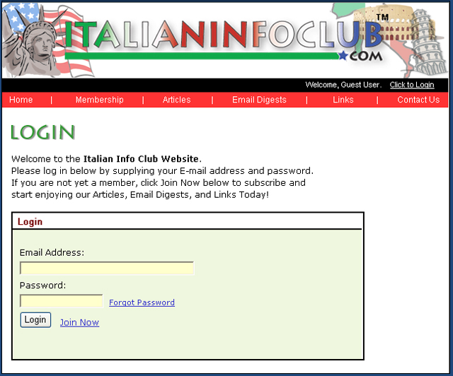
Dynamic Websites - Features
Pages are capable of providing interactivity such as:
Forms to request information or submit sales leads
Internal searches within your site
Registration and Login, personal profile maintenance, and authenticated/secure access to protected or premium content

Slide 20

Dynamic Websites - Features
Dynamic Product Catalogs and online sales (Ecommerce)
Information that is already maintained within company I.T. Systems such as Databases, Spreadsheets, and text files can be leveraged as Web Content.
Access can be granted to allow customers to maintain their own information.

Slide 21
Advantages
Dynamic web Sites… (cont.)
Much more functional website
Much easier to update
New content brings people back to the site and helps in the search engines
Can work as a system to allow staff or users to collaborate
Disadvantages
Slower / more expensive to develop
Hosting costs a little more

Slide 22
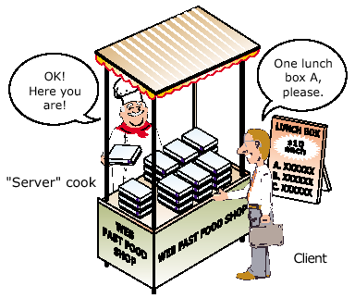
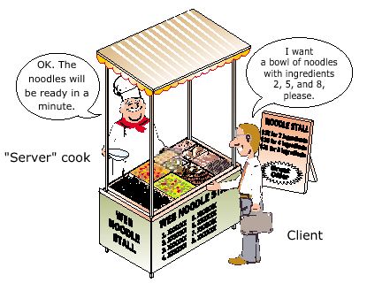
E.g. Static vs. dynamic web pages
Buying ready-made lunch boxes:
browsing static web pages
Ordering noodles in a noodle stall:
browsing dynamic web pages

Slide 23
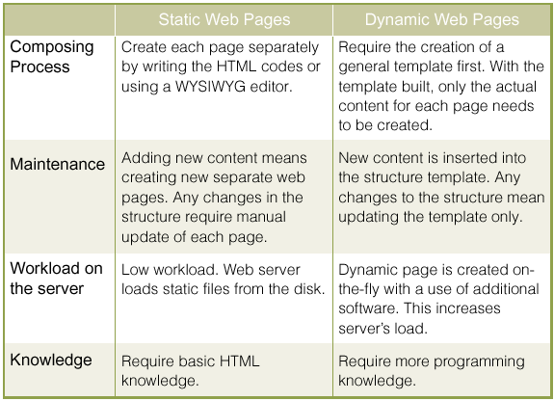
Comparison between static and dynamic web pages

Slide 24
Is Static Right for Your Organization
Static websites are a better choice when you:
are limited in budget and are starting with a core web presence
are dealing with 20 pages or less
are planning to add new pages occasionally
are assigning maintenance to a provider or have skilled staff and proper software
need of portable, physical web page files

Slide 25
Is Dynamic Right for Your Organization
Dynamic websites are a better choice when you:
need custom programming to accommodate your unique business needs
need pages that must pull information from sources external to the website proper
need to be able to easily add and edit web pages (Content) from within a browser
need web pages that will display and update records from your information systems
need to give one or more staff members access to edit the site
need convenient access to setup common interactive features such as Article Publishing, Event Calendaring, Blogs, Secure Login, Ecommerce, and others.

Slide 26
Classification of dynamic web pages
Client-side dynamic web pages
The creation of the web pages takes place in the client computer
2. Server-side dynamic web pages
The server is responsible for creating the web pages

Slide 27
Client-Side Dynamic Web Pages Vs Server-Side Dynamic Web Pages
client-side dynamic web pages
4. Client browser processes instructions and HTML codes
Client-side
Server-side
1. Client requests the web pages
3. HTML codes and instructions return to client
Client computer
Web server
5. Browser displays web pages
2. Web server looks for HTML files together with instruction files

Slide 28
Client-Side Dynamic Web Pages Vs Server-Side Dynamic Web Pages
server-side dynamic web pages
Client-side
Server-side
2. Web server looks for instruction files
1. Client requests the web pages
3.Web server processes instructions and creates the necessary HTML codes
4. HTML codes return to client
Client computer
5. Client browsers display the web pages
Web server

Slide 29
Dynamic pages architecture:
Browser
Browser requests document
e.g form on web page
Server sends complete document
Server
Server rec. CGI request
Perl Program
Program constructs new document or sends specific one that already exists
Notes:
CGI - Common Gateway Interface
The common gateway interface (CGI) is a standard way for a Web server to pass a Web user's request to an application program and to receive data back to forward to the user. When the user requests a Web page (for example, by clicking on a highlighted word or entering a Web site address), the server sends back the requested page. However, when a user fills out a form on a Web page and sends it in, it usually needs to be processed by an application program. The Web server typically passes the form information to a small application program that processes the data and may send back a confirmation message. This method or convention for passing data back and forth between the server and the application is called the common gateway interface (CGI). It is part of the Web's Hypertext Transfer Protocol (HTTP).

Slide 30
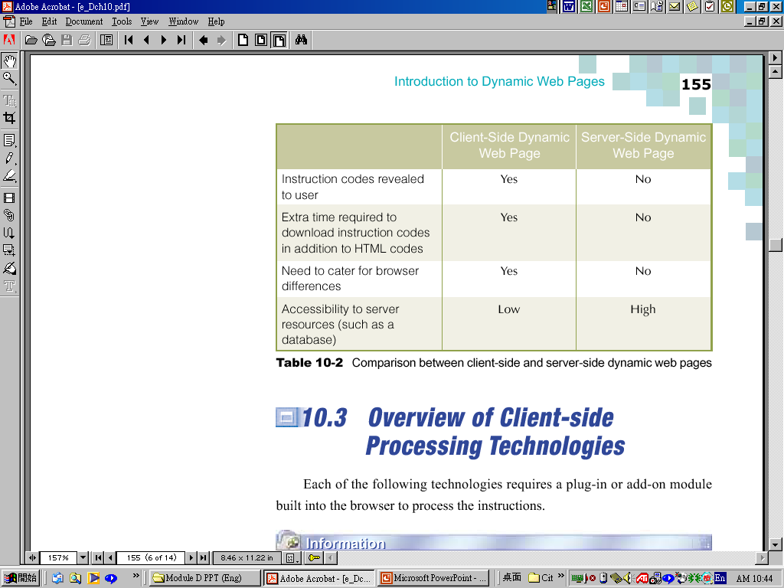
Client-Side Dynamic Web Pages Vs Server-Side Dynamic Web Pages
Comparison between client-side and server-side
dynamic web pages

Slide 31
Client-Side Processing Technologies
JavaScript
VBScript
Java
Java Applets
Common Gateway Interface (CGI)
Active Server Pages (ASP)
HyperText Preprocessor (PHP)

Slide 32
Collaborative and Syndication Web sites

Slide 33
Web syndication
A marketing strategy for websites.
A form of syndication in which website material is made available to multiple other sites.
Refers to making web feeds available from a site in order to provide other people with a summary or update of the website's recently added content
E.g. The latest news or forum posts
Web syndication describes an arrangement between two or more Internet companies for one company to provide material to be made available on the other party's site.
Syndication benefits both the websites providing information and the websites displaying it.

Slide 34
Collaborative Web sites
A collaborative Web site comprises the perpetual collective work of many authors.
E.g.
Similar to a blog in structure and logic
A wiki allows anyone to edit, delete or modify content that has been placed on the Web site using a browser interface, including the work of previous authors.
A blog, typically authored by an individual, does not allow visitors to change the original posted material, only add comments to the original content.

Slide 35
Collaborative Web sites…
Allows individuals to create or upload documents to the web where they can be.
Users can share their thoughts, projects, links, etc. with others.
Users can respond to others ideas.
Access can be restricted to selected users.
Password protection is available.

Slide 36

Blogs
“Web Logs”
A websites where entries are written in chronological order and commonly displayed in reversed chronological order.
Provide commentary or news on a particular subject.
A typical blog combines text, images, links to other blogs, web pages, and other media related to its topic.
The ability for readers to leave comments in an interactive format.

Slide 37
Blogs
Mainly one-way communication
Most blogs have feedback facilities so readers can leave comments on blog posts.
This interactivity distinguishes blogs from static websites.

Slide 38

Wikis
A website that allows the easy creation and editing of any number of interlinked Web pages, using a simplified markup language or a WYSIWYG text editor, within the browser.
Typically powered by wiki software.
Often used to create collaborative web sites, in knowledge management systems etc.
Online software tools that let a group of people contribute to the development of a document or knowledge base.
E.g. Wikipedia
Notes:
A WYSIWYG (pronounced "wiz-ee-wig") editor or program is one that allows a developer to see what the end result will look like while the interface or document is being created. WYSIWYG is an acronym for "what you see is what you get". A WYSIWYG editor can be contrasted with more traditional editors that require the developer to enter descriptive codes (or markup ) and do not permit an immediate way to see the results of the markup. The first true WYSIWYG editor was a word processing program called Bravo. Invented by Charles Simonyi at the Xerox Palo Alto Research Center in the 1970s, it became the basis for Simonyi's work at Microsoft and evolved into two other WYSIWYG applications called Word and Excel .
An HTML WYSIWYG editor, such as Microsoft's FrontPage or Adobe's PageMill conceals the markup and allows the Web page developer to think entirely in terms of how the content should appear.

Slide 39
Wikis
Needs some control over editing.
Prevent accidental or deliberate damage to the aggregated information.
Wikipedia - anonymous edits need to be approved by a moderator.
Controversial topics may be locked so only registered user, or specific users can edit them.
Often used to create collaborative web sites, in knowledge management systems etc.

Slide 40
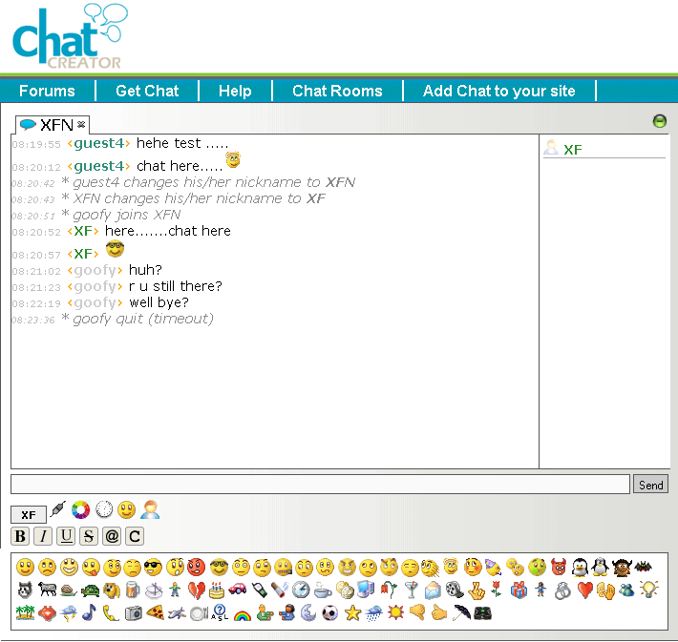
Chat rooms

Slide 41
Chat rooms
Online messaging services
Communication in real time (synchronous)
For sharing information on topics with like-minded people.
For socialising.
Lets communities interact quickly
Good for immediate plans or decisions.

Slide 42
Chat rooms
Often hosted by service providers like paltalk or via downloaded apps like Yahoo Messenger or IRC.
Many are commercial (e.g. partner-finding chatrooms).
Many are special-interest (e.g. teens, music lovers, technogeeks, gays, religious, national).
Can be international or local, large or very small.

Slide 43
Chat rooms
To join a chat room, users usually need to register.
Given a username and password for security.
Can then choose chat rooms they are interested in.
Often there are many rooms to choose from.

Slide 44
Chat rooms
Upon entry, there are usually many people already present.
Posts are shown in a scrolling window.
Users message other participants by entering their message in a textbox.
Care needs to be taken in any chat room. The real identity or nature of fellow chatters is often not what they seem to be.

Slide 45
Terms
Avatar – a nickname/identity a users assumes to protect their real name
Moderator – a person who monitors communications to ensure they follow rules and etiquette
Moderators have the power to ban, discipline, warn, educate users

Slide 46
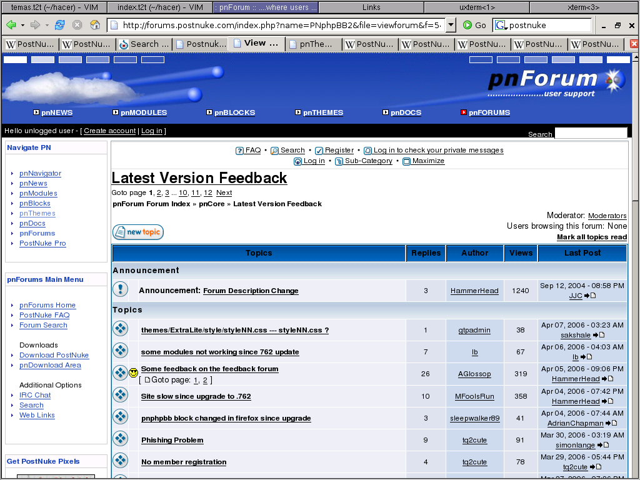
Forums

Slide 47
Forums
Also known as message boards
Asynchronous multi-user threaded message applications
Users hold conversations in the form of posted messages.
A thread is a continuous conversation of posts and replies on a specific topic.

Slide 48
Forums
Hierarchical – forum sites are usually divided into
boards (with a main topic category)
Sub-boards with subtopics of the main topic
which contain threads consisting of posts and replies.
Some threads start and end quickly if the issue is resolved or interest in it fades.
Other threads can go for years and include thousands of posts.

Slide 49
Forums
Have their own netiquette and rules
no spamming
no trolling
posts must be on-topic (or marked OT - offtopic)
no abusive language
personal arguments with individuals should be taken off-list
read the forum rules before posting
give your posts meaningful titles
banned topics must not be discussed

Slide 50
Collaboration and Social Computing
Users create and control collaborative workspaces using standard meeting and team site templates.
Coordinate teamwork with shared calendars, alerts, and notifications.
Capture best practices and expertise using blogs, wikis, Really Simple Syndication (RSS) and surveys.
Notes:
RSS is an XML-based vocabulary that specifies a means of sharing news headlines and other content between Web sites
RSS is a way of showing content (news, pictures, mp3s) without having to go to different web addresses to get it. Say you want to read the news at CNN, foxnews and read some comics. normally you would go to the sites and have all the ads and junk pop-up, but you just want the news! Enter RSS. Using programs known as "aggregators", you can see many "feeds" at the same time.

Slide 51
What is Social Networking?
Social networking is the grouping of individuals into specific groups, like small rural communities or a neighborhood subdivision, if you will.
Although social networking is possible in person, especially in the workplace, universities, and high schools, it is most popular online.

Slide 52

Social Networking

Slide 53
E.g.
Name | Description
Academia.edu | Social networking site for academics/researchers
My space | leading social entertainment destination powered by the passion of fans. Music, movies, celebs, TV, and games made social.
Facebook | Social networking for every one
Advogato | Free and open source software developers
Youtube, Twitter, etc.
Features :
Timeline
Events
Social plug-ins
Relationship Status
News feed

Slide 54
Social Networking
Sites allow people to communicate with others
Present information about themselves
Some are special-interest (e.g. green living, Indian people, genealogy, teenagers)
Others (e.g. Facebook, Twitter) have no specific theme.

Slide 55
Social Networking
Social networking groups individuals into groups based on their features
Sex
Nationality
place of residence
Age
Interests
Let people meet and share information.

Slide 56
Social Networking
Users often have a profile page where they can provide information about themselves.
Biggest social networking sites (over 10 million users) include: Classmates.com, Facebook, Flickr, Fotolog, Friends Reunited, Friendster, LinkedIn, MyHeritage, MyLife, MySpace, MyYearBook, StumbleUpon, Twitter

Slide 57
Social networking
Issues:
Stalking
Grooming
Posting identifiably personal information
Posted information will last forever - may be embarrassing in the future
Employers have sacked workers for unwise posts

Slide 58
Social networking
Employers routinely look up job applicants' social networking profiles on sites like Facebook
Addiction to (or time-wasting on) sites is an increasing cause of concern to families and employers

Slide 59
Social Networking… (cont.)
Advantages
The most cost effective way to keep in touch with your people (friends, classmates, and relatives etc.).
Not bound by any geographical and cultural differences. These sites are a window to different cultures and places.
Allows to send and receive messages, upload photos, and videos.
A tool to promote business, services, products, or websites. Etc.
Disadvantages
The risk of identity theft and fraud.
The personal information of users can be used by dubious people for illegal activities. Information like the e-mail address, name, location, and age can be used to commit online crimes.
If you do not know the person face to face then it will be very hard for you to find the real identity.
Online harassment and stalking

Slide 60
Web 1.0 Vs. Web 2.0

Slide 61
Web 1.0
Sir Tim Berners‐Lee
Uniform access to disparate sources of information, without differences between data sources
Web 1.0, or web, refers to the first stage of the World Wide Web linking WebPages with hyperlinks.
Hyperlinks between WebPages began with the release of the WWW to the public in 1993

Slide 62
Web 1.0 … (cont.)
Some design elements of a Web 1.0 site include:
Static pages instead of dynamic user-generated content.
The use of framesets
The use of tables to position and align elements on a page.
These were often used in combination with "spacer" GIFs (1x1 pixel transparent images in the GIF format.
HTML forms sent via email.

Slide 63
Web 2.0
The term Web 2.0 is associated with web applications that facilitate participatory information sharing, interoperability, user-centered design and collaboration on the World Wide Web.
A Web 2.0 site allows users to interact and collaborate with each other in a social media dialogue as creators of user-generated content in a virtual community.

Slide 64
Web 2.0 … (cont.)
E.g.
social networking sites
facebook, Twitter, Flicker, MySpace etc.
Blogs
Wikis
MSN
video sharing sites
YouTube etc.
hosted services

Slide 65
Web 2.0 … (cont.)
Emerging Technology
Web Services / API’s
“Folksonomies” / Content tagging
“AJAX”
RSS
Applications You
Know…
Flicker
Google Maps
Blogging & Content Syndication
Amazon API’s
Google Adsense API
Yahoo API
Ebay API
Major Retailers

Slide 66
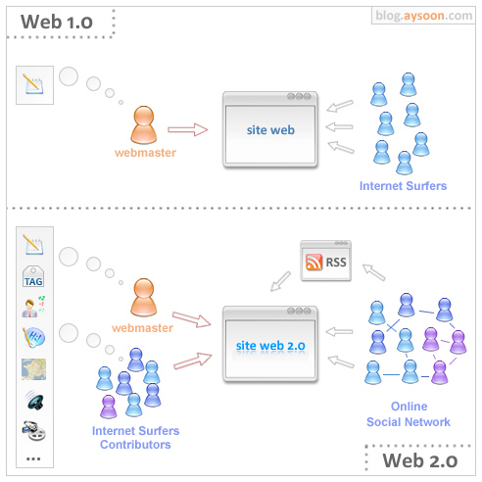
Notes:
RSS - Really Simple Syndication

Slide 67
Web 2.0: Evolution Towards a Read/Write Platform
Web 1.0 (1993-2003) Pretty much HTML pages viewed through a browser |  | Web 2.0 (2003- beyond) Web pages, plus a lot of other “content” shared over the web, with more interactivity; more like an application than a “page”
“Read” | Mode | “Write” & Contribute
“Page” | Primary Unit of content | “Post / record”
“static” | State | “dynamic”
Web browser | Viewed through… | Browsers, RSS Readers, anything
“Client Server” | Architecture | “Web Services”
Web Coders | Content Created by… | Everyone

Slide 68
WEB 1.0 Vs. Web 2.0
WEB 1.0 | WEB 2.0
“the mostly read only web” | “the wildly read-write web”
focused on companies e.g. Dot com, Bubble | focused on communities e.g. MySpace, Facebook
home pages | blogs
owning content | sharing content
HTML, portals | XML, RSS
web forms | web applications
directories (taxonomy) | tagging ("folksonomy")
about wires | about wireless.
Netscape | Google
dial up | broadband
Yahoo mail 1998 with 2 MB of storage. | Google Mail (Gmail) with 2GB of storage.

Slide 69
Lesson Review
Differentiate Static and Dynamic web sites.
Differentiate collaborative and Syndication web sites.
Differentiate Web 1.0 Vs. Web 2.0.
Describe how to migrate contents from Web 1.0 to Web 2.0.
Identify web sites under following categories
Static and Dynamic
Collaborative and Syndication
Web 1.0 and Web 2.0

